Slide 1

DEYAAR DEVELOPMENT PJSC
INVESTOR RELATIONS
INFORMATION FOR THE
YEAR 2017

Slide 2

DISCLAIMER
The information set out in this presentation is being made available to recipients for information purposes only. It does not constitute, nor is it intended to be an offer to sell, or an invitation to subscribe for, or purchase, any properties or shares in the Company.
Neither this presentation nor anything in it shall form the basis of any contract or commitment.
The information contained herein has been prepared to assist the Recipients in making their own evaluation on the Company and does not purport to contain all information that they may desire. In all cases, the Recipients should conduct their own investigation and analysis of the Company, its business, prospects, results of operations and financial condition as well as any other information the Recipients may deem relevant to their decision making.
The Presentation is at the date hereof.
Without the express prior written consent of the Company, the Presentation and any information contained within it may not be reproduced (in whole or in part), copied at any time, used for any purpose other than evaluation of the Company.
1
www.deyaar.ae

Slide 3

DEYAAR AT A GLANCE
OWNERSHIP STRUCTURE
STRATEGY HIGHLIGHTS
FINANCIAL HIGHLIGHTS
ONGOING DEVELOPMENTS
TABLE OF CONTENTS
2

Slide 4
DEYAAR AT A GLANCE
3

Slide 5

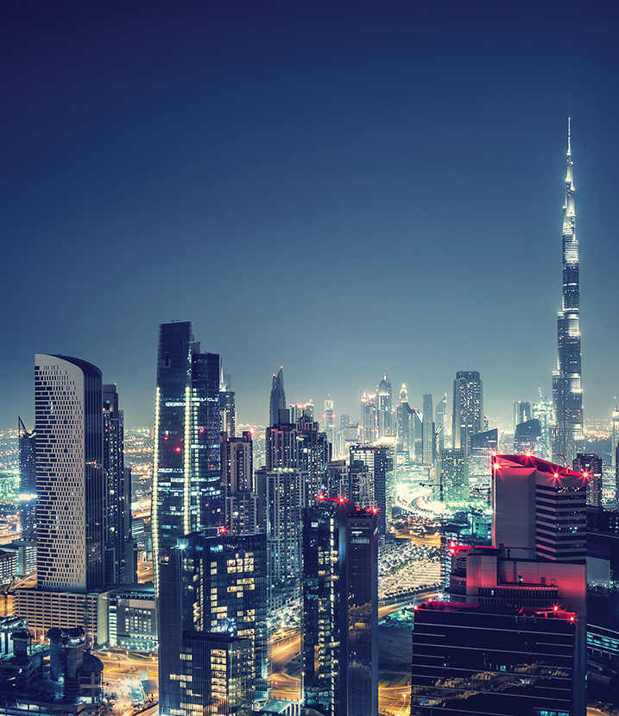
ABOUT DEYAAR
Deyaar Development PJSC is a leading real-estate organization in the region.
Headquartered in Dubai, the company has grown significantly since its inception in 2002 to evolve into a complete one-stop real-estate solutions provider in property development, facilities management, property management and owners’ association management, with a share capital of AED 5.78 Billion following its IPO in May 2007.
4
www.deyaar.ae

Slide 6

VISION AND MISSION
VISION
To be known as a trusted, integrated real-estate Partner, creating value for stakeholders, society and the economy.
MISSION
To create an urban environment that meets the high standards set by the nation’s leaders, with a diverse portfolio of quality real estate developments and differentiated services, a return on investment for stakeholders and value for customers, whilst providing the tools to our employees to realize their potential.
CORE VALUES
Ethical and transparent; Enterprising and agile, Trustworthy and reliable, Quality and Value conscious and committed to the transformation of the UAE under our leadership.
5
www.deyaar.ae

Slide 7
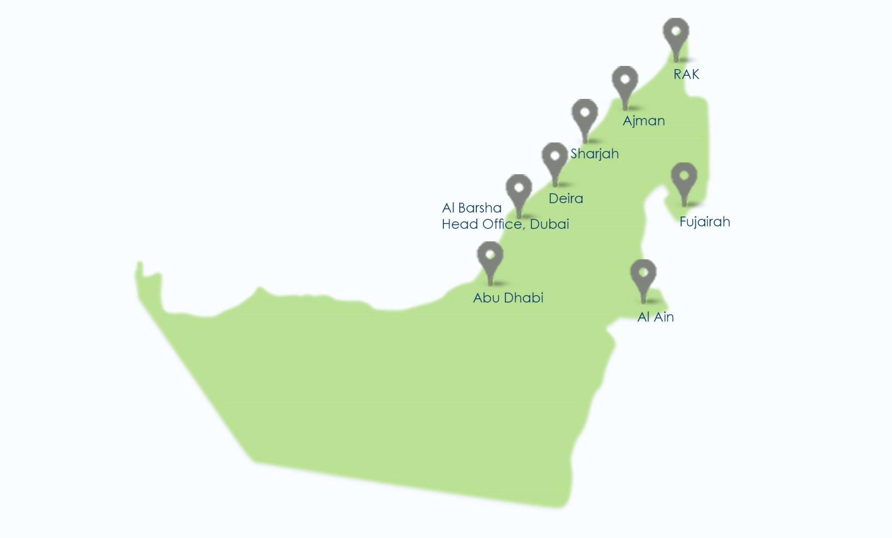
OUR PRESENCE IN THE UAE
6
www.deyaar.ae
Notes:
(optional slide)

Slide 8
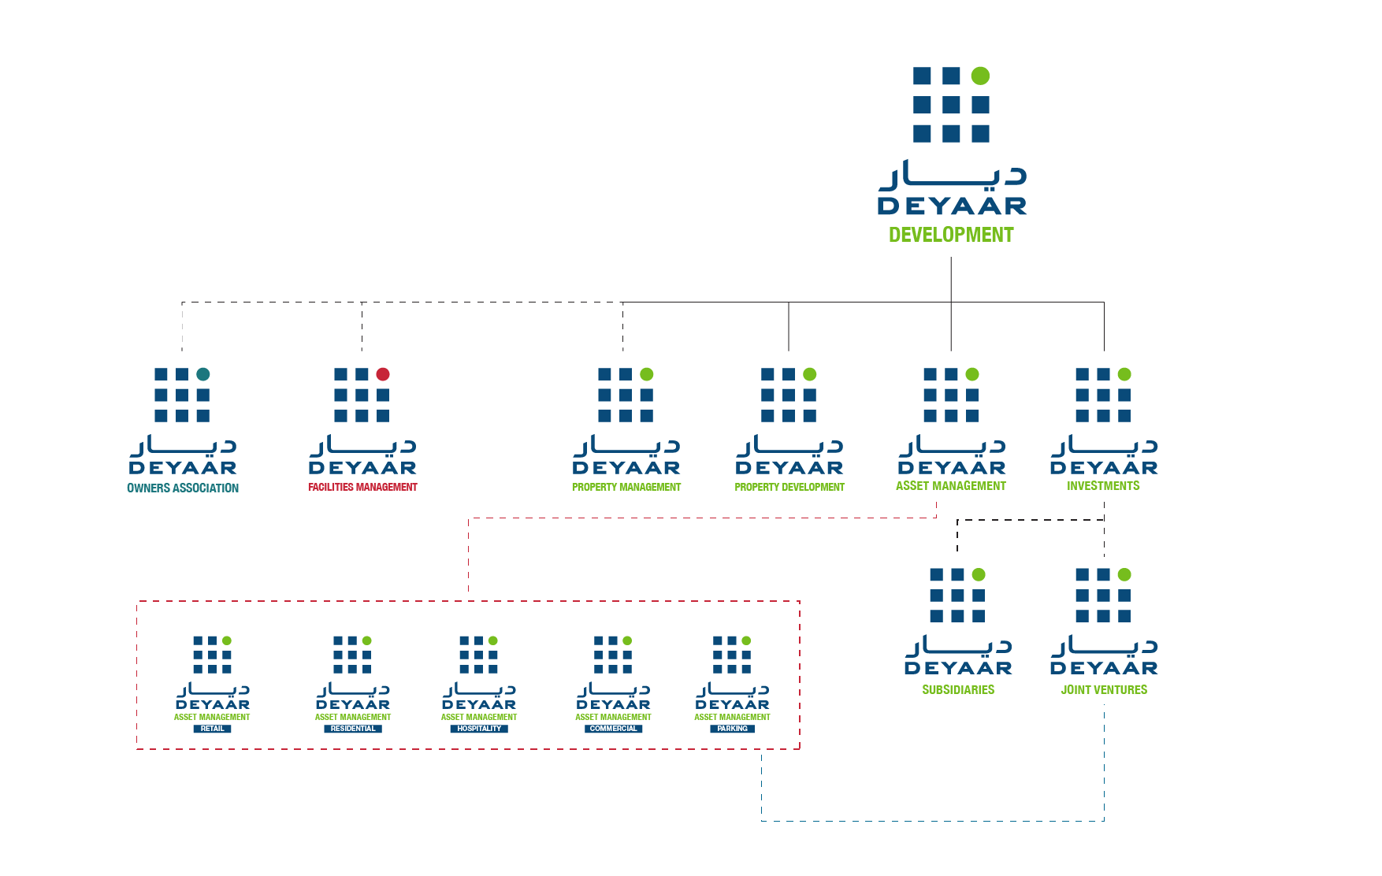


GROUP BUSINESS STRUCTURE
ASSOCIATES
ARADY DEVELOPMENTS (50%)
SKY GARDENS (33%)
Al ZOHRA (10%)
7
www.deyaar.ae

Slide 9
MANAGEMENT TEAM
Saeed Al Qatami
Chief Executive Officer
Hani Fansa
Chief Financial Officer
Srinivasan Krishnaswamy
VP Business Development & Strategic Planning
Nasser El Din Aly Amer
VP Sales
David Milligan
Head of Projects & Commercial
Mona Altamimi
VP Marketing & Corporate Communications
Ghassan Shehadeh
VP Operations & Collections
Ali Sharif
VP Human Resources
Mohammad A. Khamis
General Manager - Facilities Management
Rabindran Thaver
Acting head – Property Management
Bassam M. El-Ghawi
Chief Audit Executive – Internal Control
8
www.deyaar.ae

Slide 10
OWNERSHIP STRUCTURE
9

Slide 11
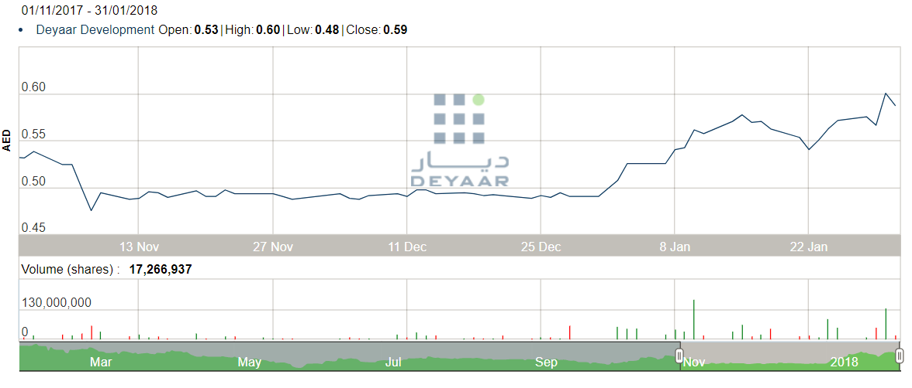
OWNERSHIP STRUCTURE & STOCK UPDATE
Above chart represents share price movement for last three months.
Deyaar’s share were listed in Dubai Financial market following its IPO in May 2007.
10
www.deyaar.ae

Slide 12
STRATEGY HIGHLIGHTS
11

Slide 13
ACHIEVE GROWTH, SUSTAINABILITY AND PROFITABILITY BY FOCUSING ON DEYAAR'S CORE STRENGTHS
Growth
Property Development
Asset Management
Allied Services
(Property, Facilities and Owner Association Management)
Create Value
Projects across real estate segments: affordable, prime and luxury
Help achieve top line and bottom line growth
New projects are always evaluated based on VALUE created for our stakeholders (customers, shareholders, business partners and employees) and for Deyaar
Adopt innovative new technologies for increasing efficiency and delivery times
Diversify business by development of multi purpose and multi-targeted developments including under JV structure
Enhance, Expand and
Manage Asset Portfolio
Generate recurring revenues & income
Steady cash-flows and profit to enhance sustainability
Aid growth of company by Retaining assets in Deyaar Projects (BTL) and acquiring assets
Adequate coverage of G&A & other cost at corporate level
Enhance liquidity by financing options (leverage)
Create sustainability by diversification into hospitality assets
Customer Satisfaction
Focus on achieving Quality and delivering satisfaction
Growth and sustainability by adhering to globally accepted service standards
Increase contribution to Deyaar’s profitability by bringing new assets under management
Create brand value for Deyaar through endeavors to achieve highest levels of customer satisfaction
Sustainability
Profitability
GOVERNANCE
12
Create an environment of control and risk consciousness in line with the applicable corporate governance framework.

Slide 14
FINANCIAL HIGHLIGHTS
13

Slide 15
OVERVIEW
YEAR 2017 FINANCIAL HIGHLIGHTS
Strong year-on-year revenue growth to AED 751.6 million [2016: AED 428.3 million]
Particularly strong growth in property development revenues, which reached AED 617.5 million [2016: AED 307.5 million], following good progress in Deyaar’s flagship projects
Healthy net profit of AED 130.4 million [2016: AED 216.1 million, included gain of AED 75.5 million from fair value adjustment on investment properties and AED 68.9 from write back of provision for impairment of investment in an associate]
14
www.deyaar.ae

Slide 16

OVERVIEW continued
15

Slide 17
BALANCE SHEET continued
16
www.deyaar.ae

Slide 18
ONGOING DEVELOPMENTS
17

Slide 19
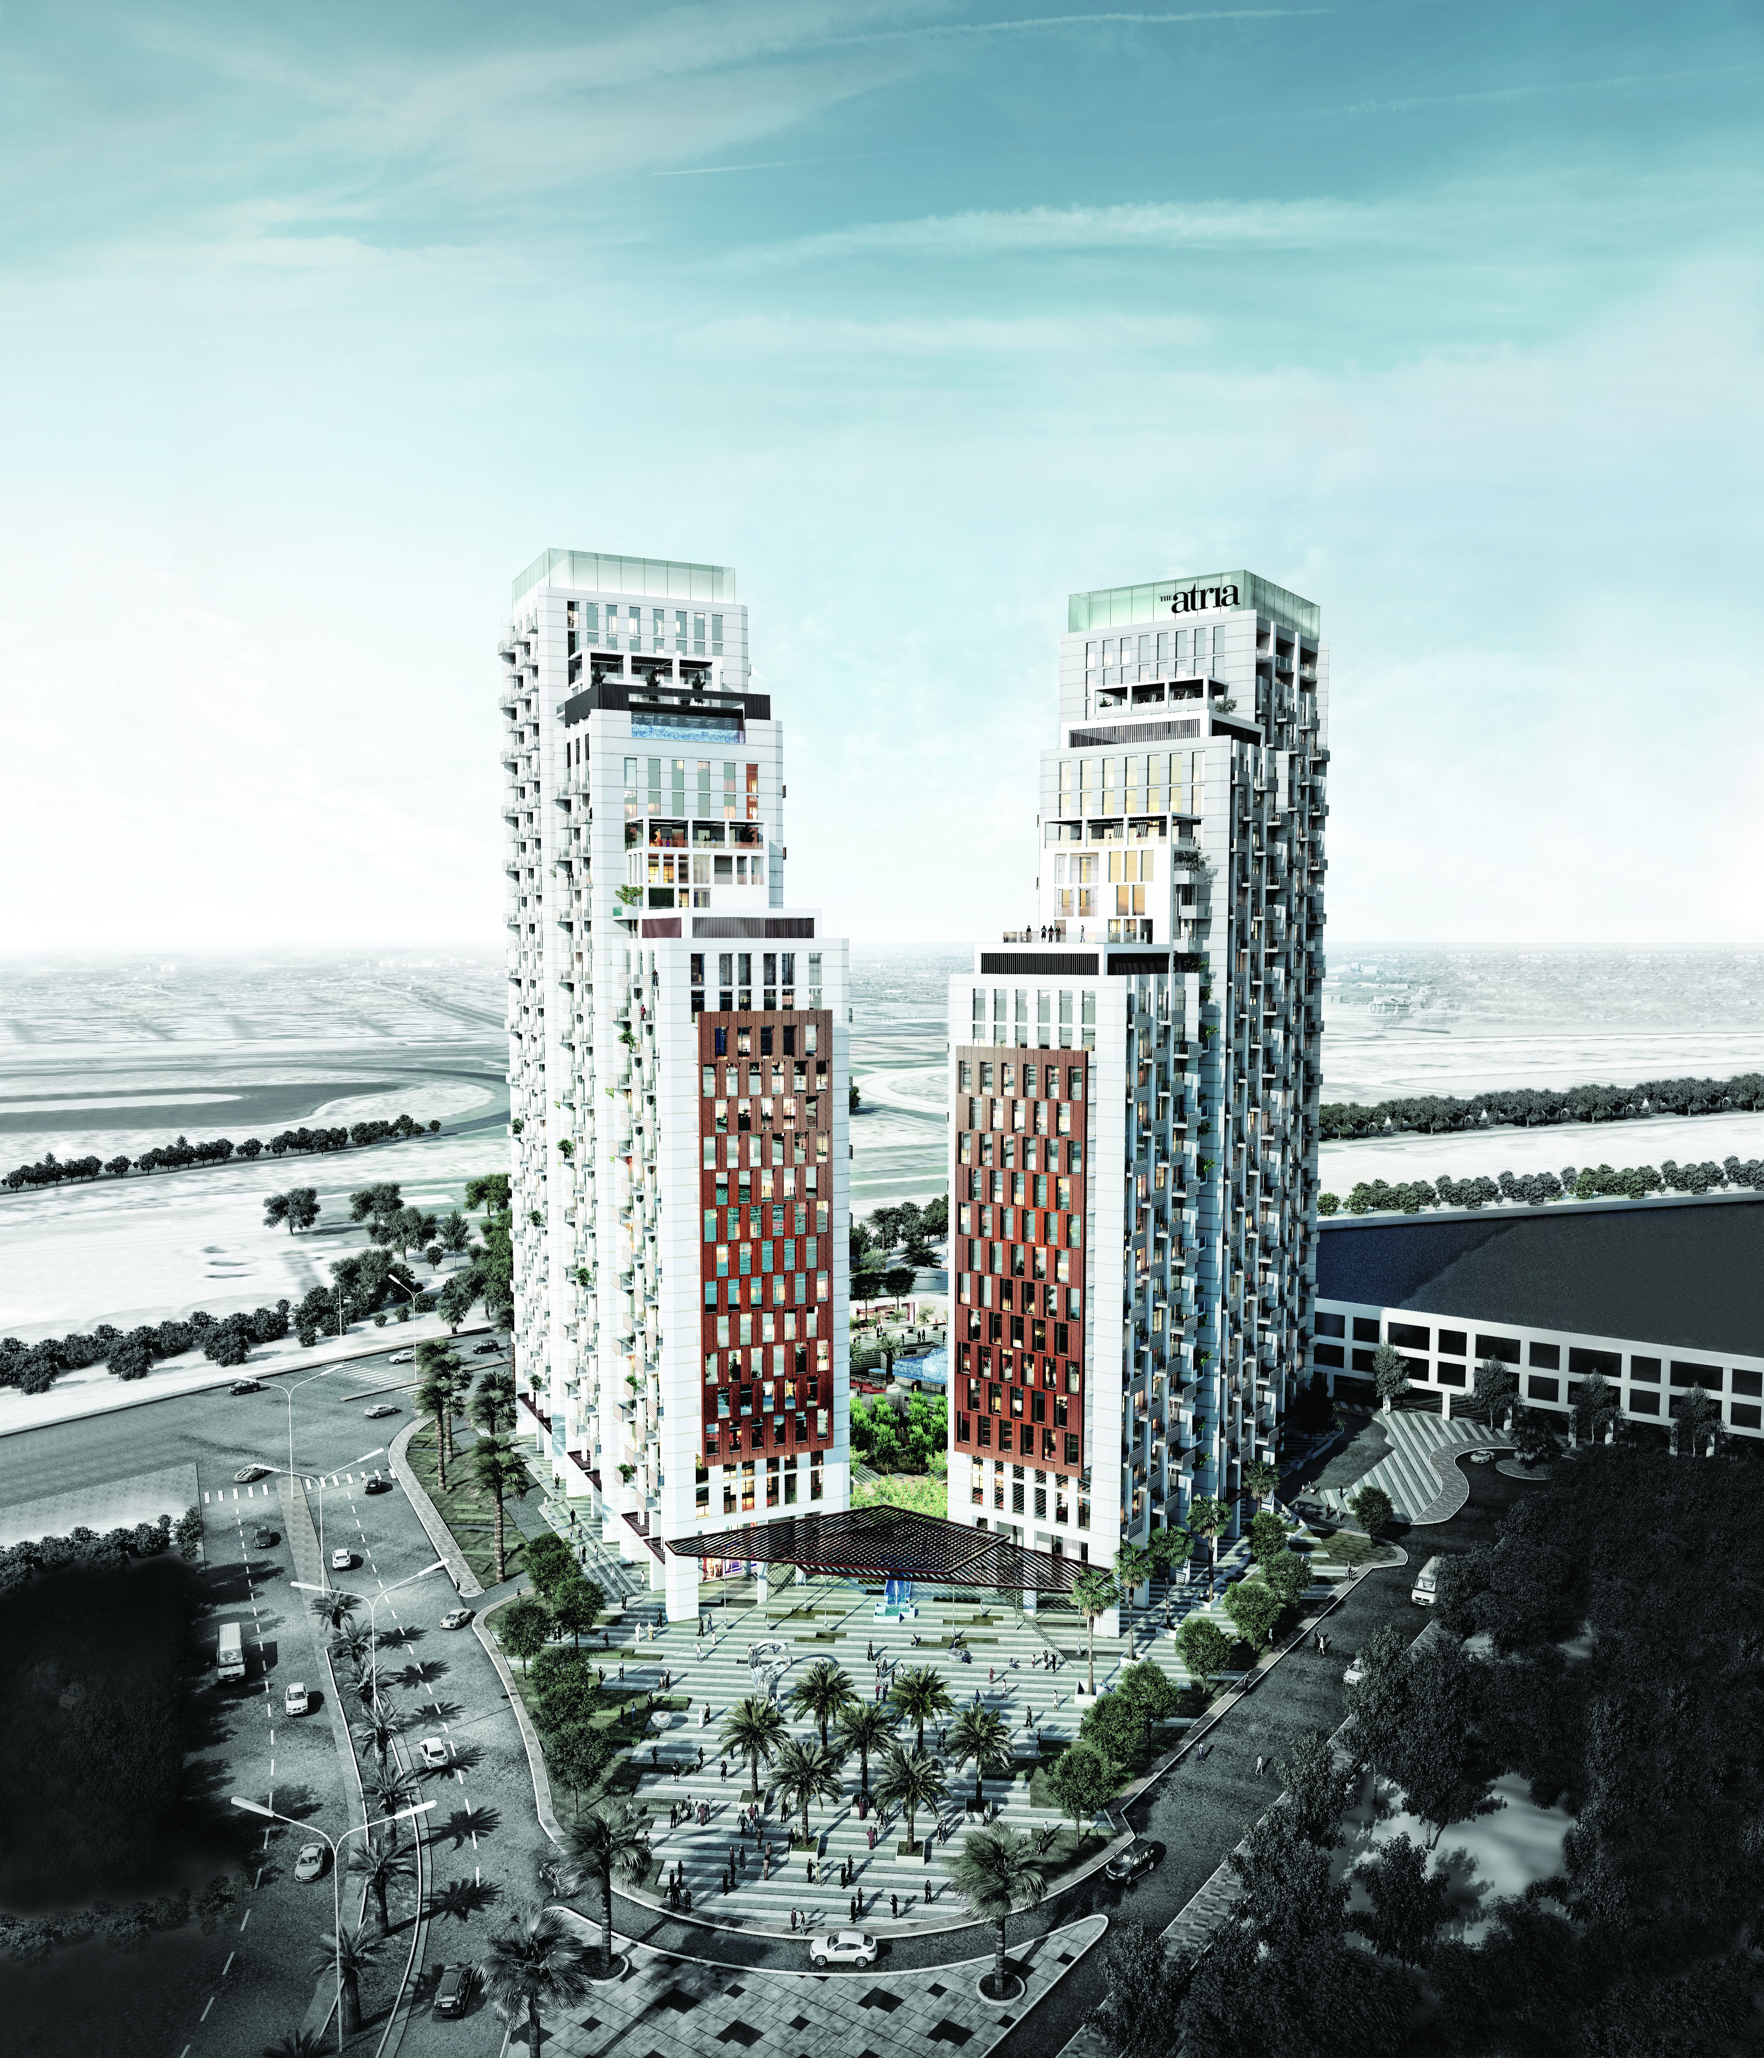
ATRIA – Business Bay Area
RESIDENTIAL APARTMENT
Total sales value (AED mil): 547
Total number of units (count): 219
Units sold till date (count): 204
Percentage of Portfolio for sale: 100%
SERVICE APARTMENT
Total sales value (AED mil): 718
Total number of units (count): 347
Units sold till date (count): 96
Percentage of Portfolio for sale: 50%
PROJECT CURRENT COMPLETION STATUS
Overall 93.9%
PROJECT EXPECTED COMPLETION DATE
Quarter 1 - 2018 (RESIDENTIAL)
Quarter 2 - 2018 (SERVICE)
18
www.deyaar.ae

Slide 20
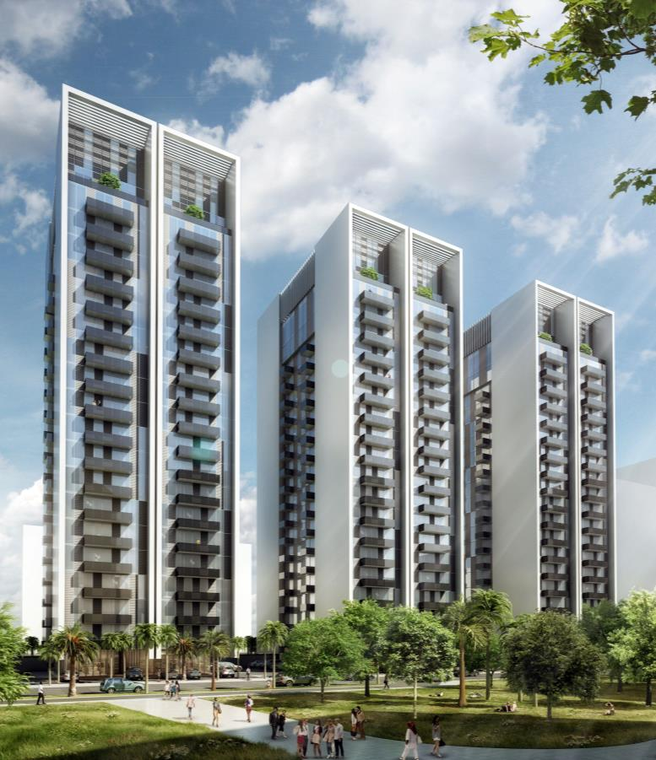
MONTROSE – Dubiotech Area
RESIDENTIAL APARTMENT –
TWO BUILDINGS
Total sales value (AED mil): 339
Total number of units (count): 297
Units sold till date (count): 281
Percentage of Portfolio for sale: 100%
SERVICE APARTMENT – ONE BUILDING
Total sales value (AED mil): No sales value as units under hotel operation
Total number of units (count): 198
Units sold till date (count): N/A
Percentage of Portfolio for sale: N/A
PROJECT CURRENT COMPLETION STATUS
Overall 97.6% (RESIDENTIAL)
Overall 81.3% (SERVICE)
PROJECT EXPECTED COMPLETION DATE
Quarter 1 - 2018 (RESIDENTIAL)
Quarter 2 - 2018 (SERVICE)
19
www.deyaar.ae

Slide 21
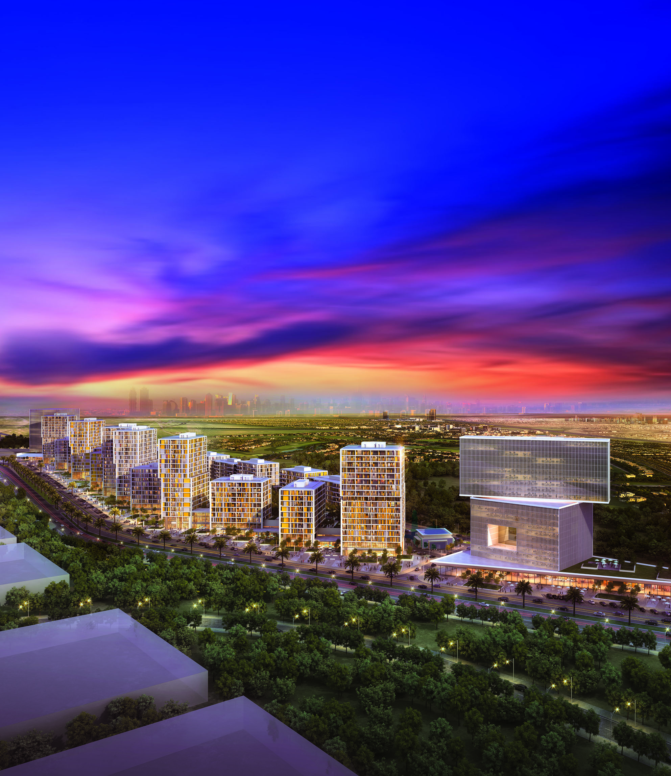
MIDTOWN – IMPZ Area
RESIDENTIAL APARTMENT - TWO DISTRICTS
Total sales value (AED mil): 937
Total number of units (count): 1238
Units sold till date (count): 945
Percentage of Portfolio for sale: 100%
SERVICE APARTMENT
Total sales value (AED mil): under initial pre-concept study
Total number of units (count): 786
Units sold till date (count): 0
Percentage of Portfolio for sale: 0%
PROJECT CURRENT COMPLETION STATUS Overall 23.1%
PROJECT EXPECTED COMPLETION DATE Quarter 4 - 2019
20
www.deyaar.ae

Slide 22
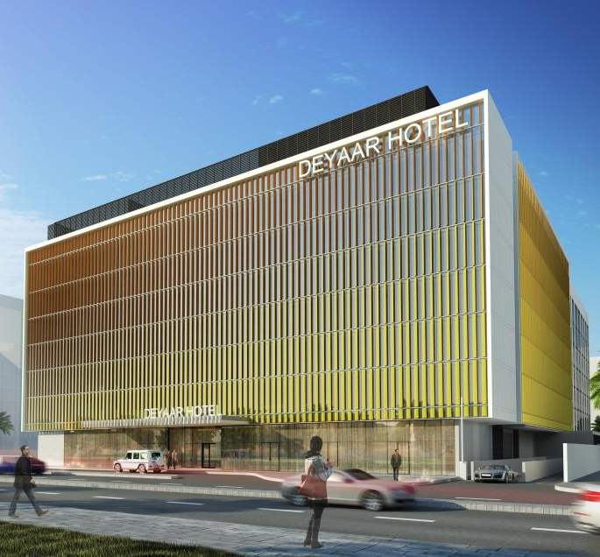
BARSHA HOTEL – Al Barsha Area
HOTEL & SERVICE APARTMENT
Total sales value (AED mil): No sales value as units under hotel operation
Total number of units (count): 408 keys
Units sold till date (count): N/A
Percentage of Portfolio for sale: N/A
PROJECT CURRENT COMPLETION STATUS Overall 31%
PROJECT EXPECTED COMPLETION DATE Quarter 3 - 2018
21
www.deyaar.ae

Slide 23
SIGNIFICANT 2017 ACTIVITY
Signed MOU with Dubai South to establish a 50-50 joint venture for a major mixed-use project comprising residential property, retail and hospitality facilities on a location adjoining the Expo 2020 Dubai site
Showcased Midtown by Deyaar, The Atria and Montrose, to Chinese investors at the Dubai Property Show in Shanghai from March 24-26, 2017
Deyaar Property Management achieved ISO 9001:2008 certification for quality
Site tour of The Atria and Mont Rose for UAE media. Both projects are now over 85 per cent complete
22
www.deyaar.ae

Slide 24

THANK YOU

